Slide 1
Live your values
Transform your culture
Achieve your mission
Leading with Power
Jeff Thompson, MD

Slide 2

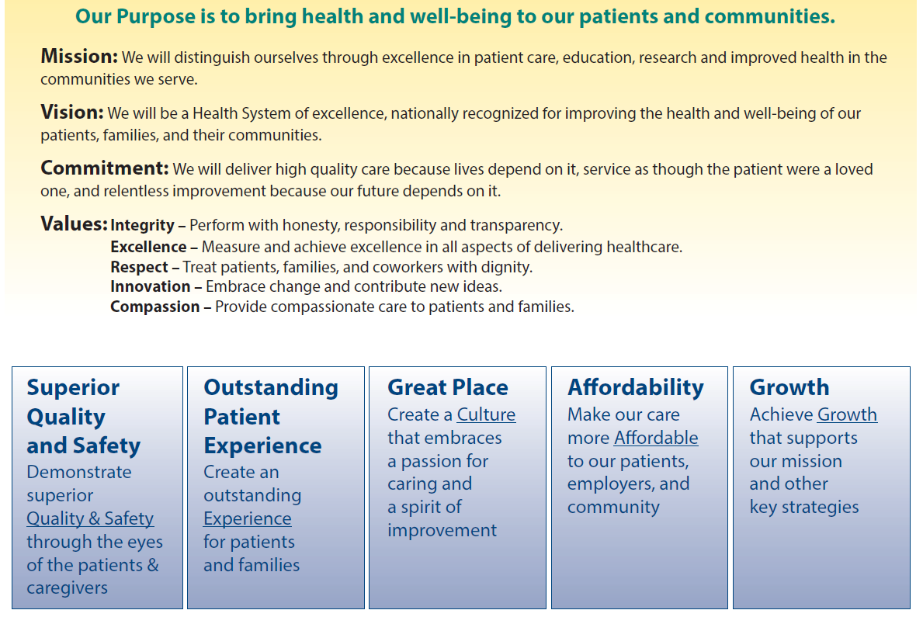

Slide 3
Purpose – Why?
Mission – How?
Vision – Where we will get to?
Values – What will be the culture?

Slide 5
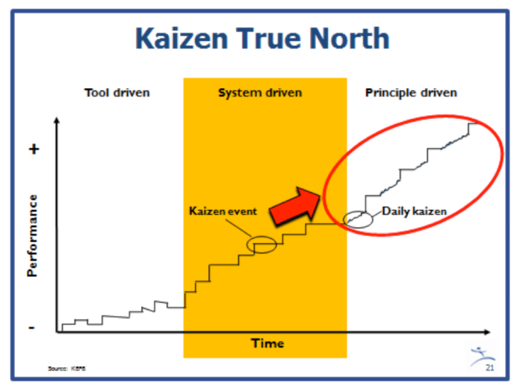
http://www.lean.org/Workshops

Slide 6
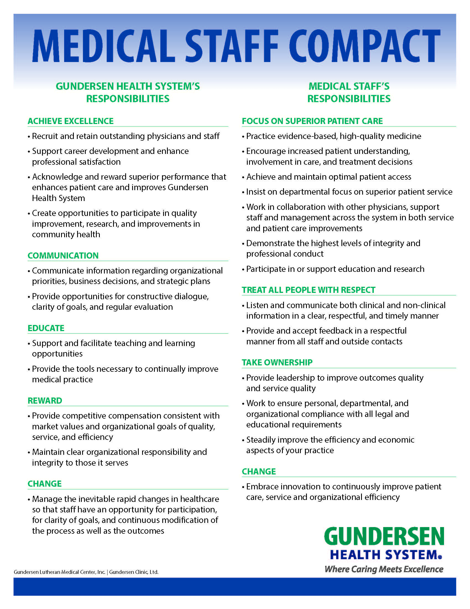

Slide 7
Culture of Development: Talent Review Nine Box
 | Potential
Performance |  | High |  | Low
 | High | j
 | DC Low
GE Nine Box System

Slide 8
“You cannot give what you do not have....if they don’t feel cared for...they can’t care...to embrace...you have to have been embraced. To respect you have to have been respected....don’t be stunned by your staff’s lack of care, connection , or respect if they have not, through their eyes, been cared for...connected with...and respected.”
- Maureen Biganano

Slide 9
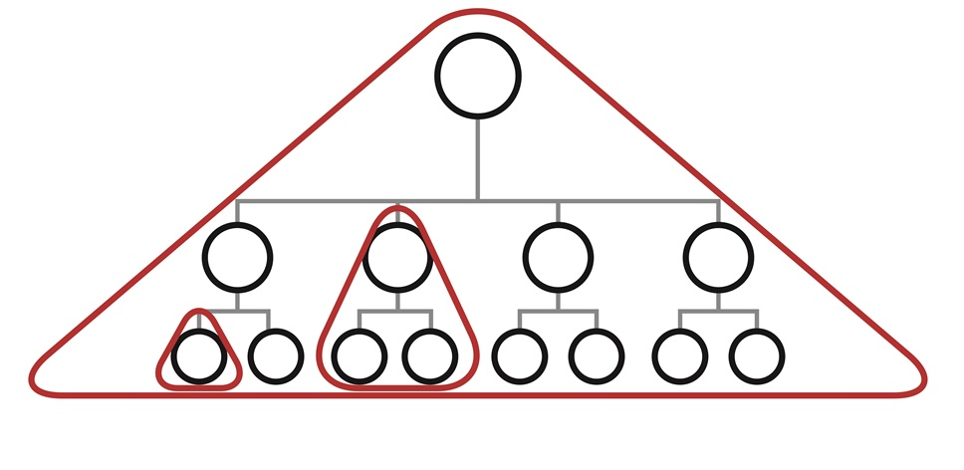

Slide 10
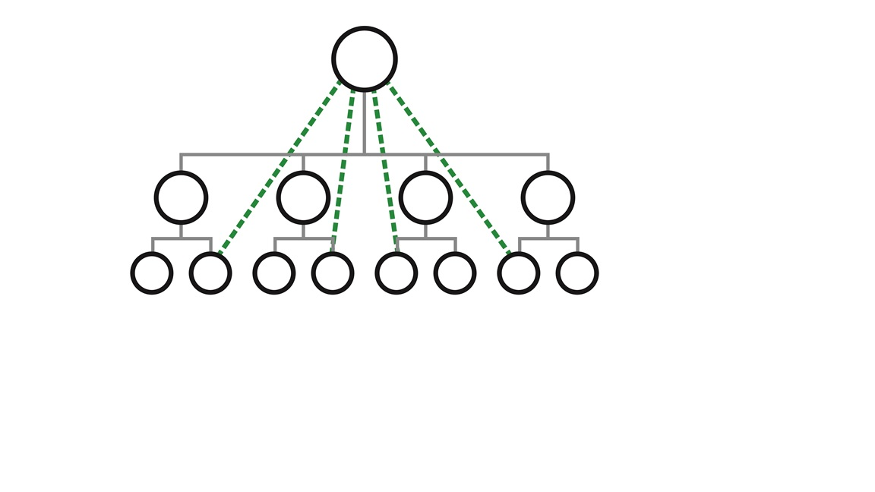

Slide 11
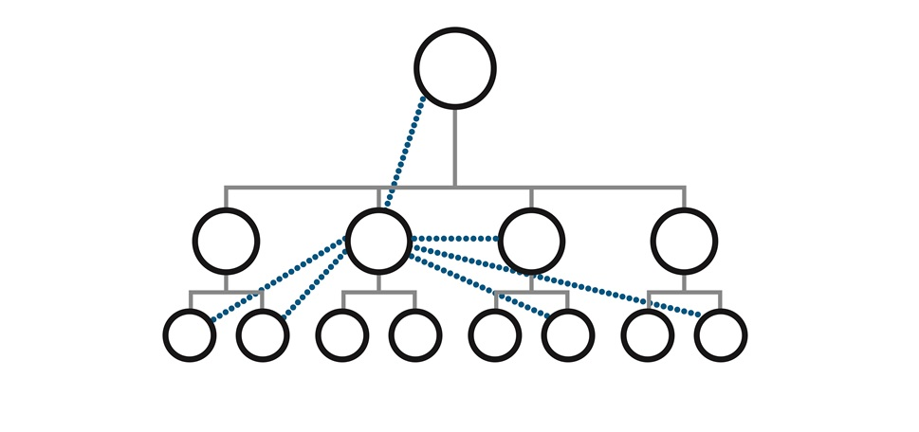

Slide 12
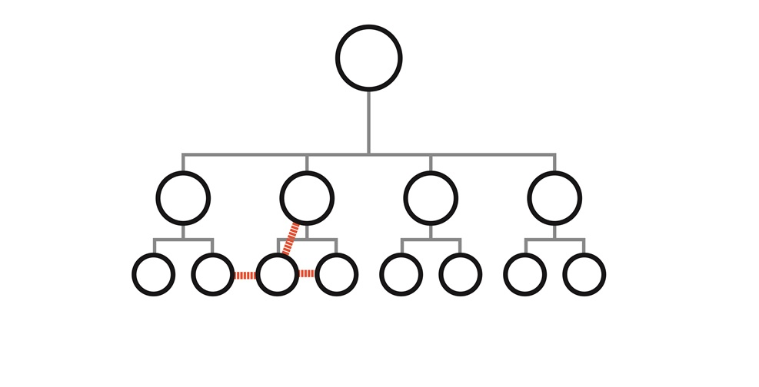

Slide 13
Ultimate Goal
Superior value
Best place to work, get service, care, education, products
Measureable rapid improvement; markedly increased staff ownership
Markers of Success
Hitting national levels of excellence…recognized as great
Transformation Tools
Broad transparency, Deep communication, Consistent mgmt system, Reverence for staff, Mission based incentives
What it takes to become great
Must Do’s
How we run the business good
Safer, more reliable outcomes for staff and those you serve
Compliance, Fiscal Discipline, Core Competencies
The guide for organization, department, individuals
Direction
Courage to Live the Mission, Vision, Values.
Clarity and use of Strategic Plan and
Compact for all staff

Slide 14


Slide 15
Choices
At each fork in the road, your decision changes you – and the world.

Slide 16
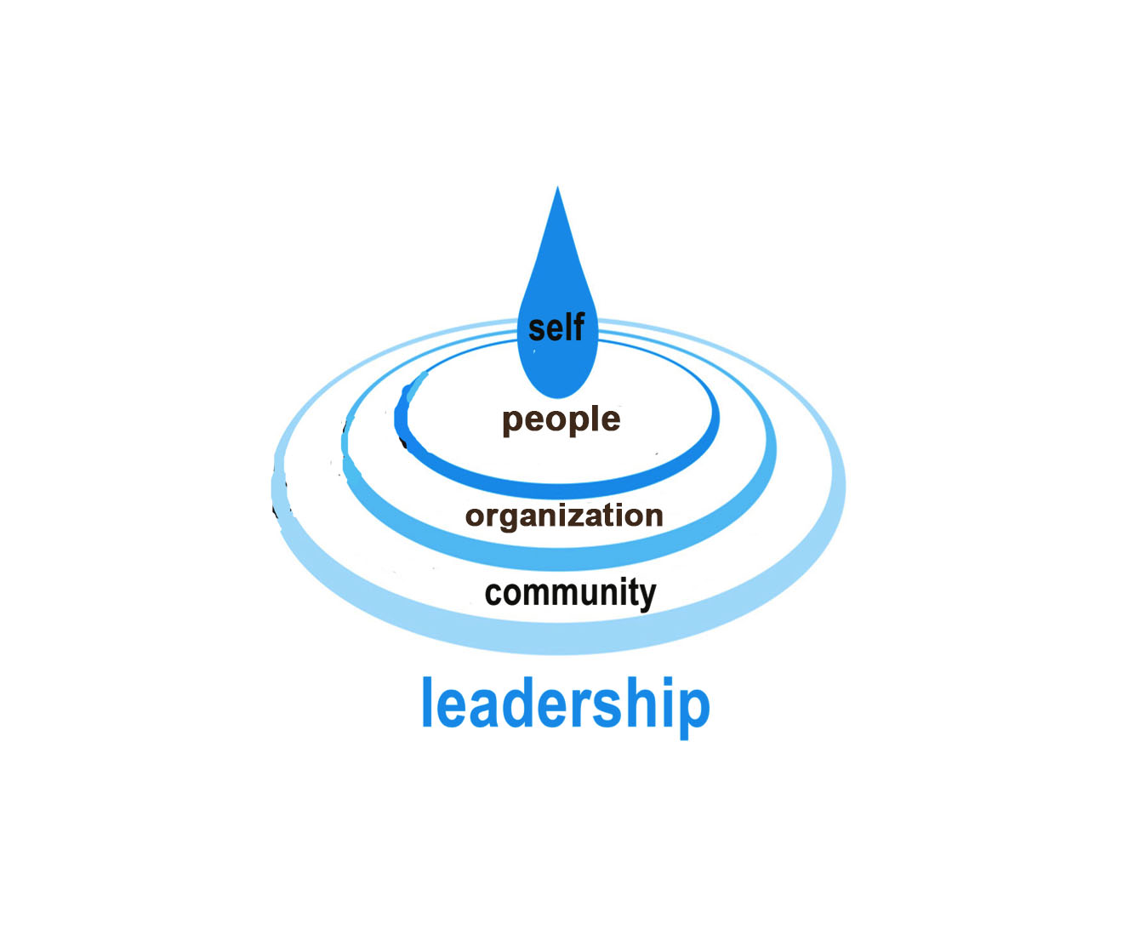

Slide 17
Lead with Courage
Courage doesn’t mean the absence of fear; it means fear doesn’t get to make your choices

Slide 18
Takeaways
Courage is not the absence of fear.
Making a courageous decision puts vision and virtue ahead of your own interests.
Courage is called the “first virtue,” because it is the foundation for all the others.

Slide 19
Lead with Discipline
Discipline keeps you from drifting off the cliff

Slide 20
Without discipline, courageous decisions go nowhere and will do little good.. Discipline gives courage legs.

Slide 21
The ripple effect of under managed poor performance of leaders is enormous

Slide 23
Lead with Durability
Durability carries the courage and discipline through the struggle.

Slide 24


Slide 25
Lead with Reverence
People won’t remember your margins or your awards; they will remember how your treated them.

Slide 26
No one’s ego is more important than the well-being of the patient or staff

Slide 27
What you tolerate you support.

Slide 28
Holding accountable is looking backward, being responsible for their success is looking forward.

Slide 29
Holding people accountable is looking backward, being responsible for their success is looking forward. Optimal performance will happen with balance.

Slide 30
The more special and protected we treat our executives, the less special and afraid the staff feel.

Slide 31
The chain of command is always a weak link in the communication chain

Slide 32
Humble listening builds strong bonds to deeper values.

Slide 33
Lead to Exceed
Have the courage to measure and improve on excellence

Slide 34
Being better than your mediocre past is not excellence.

Slide 35
There is often a big gap between doing something and accomplishing something.

Slide 36
We need to move past the notion of excellence on the basis of reputation, marketing budgets, or size, and expect greatness to be described by broad outcome measures across time, demographics, and sectors of the community

Slide 37
Innovate to Serve Values

Slide 38
Innovation Keys:
Get close enough to the work to feel the moral imperative.
Use structure to improve innovation.
Maintain a disciplined disregard for conventional wisdom.

Slide 39
We had to ignore the conventional wisdom of the day, which says a choice must be made either between jobs and the environment, or between cost savings and the environment.

Slide 40
Small-market competition is best replaced by disciplined, values-driven systems that commit to transparent, measurable improvements in the community’s wellbeing.

Slide 41
Funds and Foundations to Serve Your Values
Finances and facilities are tools – important, useful tools, but just tools

Slide 42
Lead Across the Divide
Same values + big tent = great strengths

Slide 43
Coalitions of competitors can find common values and common goals.

Slide 44
The cultures of the partners don't have to match exactly, but you have to have similar values and similar goals. If you don't have similar values, then working together is going to be a mess, and if you don't have the same goals, then you won’t be heading in the same direction and the partnership will lose focus and disintegrate

Slide 45
Serving
the greater good
Finance/Facilities/
Partnership as tools
Focus Department/organization on Excellence, Innovation,
Treating Staff with Reverence and Deep Communication
Courage/Discipline/Durability
Clear Values to Guide Choices

Slide 47
Conclusion
When values lead, we all win.

Slide 48
Jeff Thompson, MD
Executive Advisor, CEO Emeritus
jethomps@gundersenhealth.org
http://jeffthompsonmd.com
www.gundersenhealth.org

